Slide 1
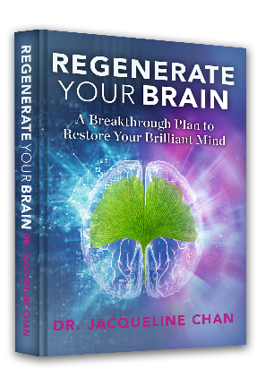
The Wheel of Wellness Diet, Supplements, Lifestyle
Dr. Jacqueline Chan
Notes:
Despite the explosion of new discoveries in neurosciences a silent tragedy is occurring…We are slowly losing our minds. We are being exposed to an unprecedented amount of information – and what information grabs is attention. .If you are listening to this masterclass you may be suffering from an anxious mood, persistent distress, agitation, an inability to focus, insomnia, feeling overwhelmed, exhausted or you’ve simply lost your mojo. Worse yet, someone in your family may have dementia, Parkinson’s, multiple sclerosis, stroke, autism, mental illness or addiction. Or you may know of someone who has suffered a concussion and never been the same. Up to ¼ of U.S. Citizens is on a psychotic drug and dementia is now the 6th leading cause of death plus there is a 16% increase in learning disability. The good news is the brain can regenerate new tissue and develop new pathways for relativity, ingenuity, joy and resilience.
OR
Although the field of neuroscience has made tremendous progress over the past couple of decades, understanding the essential principles of brain function, and putting that knowledge to personal use, is still far more unknown than known. The RYB program offers a comprehensive and user-friendly plan to help you with your day to day choices related from the food you eat and the activities you engage in which powerfully influence your brain’s functionality and resistance to degeneration. The RYB program eloquently presents not just why these choices matter, but how they can be easily implemented for your better brain. on this all important subject I have ever come across and I highly recommend it to anyone seeking greater health and

Slide 2
Disclaimer:
This is not intended as a substitute for the diagnosis, treatment and advice of a qualified licensed medical professional. The author, publisher and distributors of this workshop offer no responsibility for how this material will be used.

Slide 3
Overview
Monday: Wheel of Wellness: diet, lifestyle, supplements 10% experiential
Tuesday: Why is Sleep Crucial 50% experiential
Wednesday: Deep rest for the Mind 50% experiential
Thursday: Neuro-regenerative practices to build new neural pathways- 80% experiential

Slide 4
What’s going on today?
26% of Americans are on an psychiatric medication at some point in their lives
Learning disabilities in children are increasing 16%
Neurodegenerative disorders are increasing 30%
1 out of every 3 Americans will get cancer

Slide 5
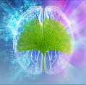
Alzheimer’s
2/25/2019 CDC estimates conservatively that 6th leading cause of death is Alzheimer’s Disease
60% of care givers of Alzheimer’s get dementia
There is a decade of impairment before it happens

Slide 6
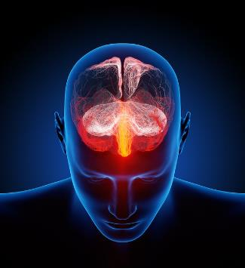
We need our wellness for:
Higher executive functioning
Our ability to be productive in society
Critical thinking
Our ability to emotionally connect
Compassion and judgment.

Slide 7
The Good News About Brain Care!
We can control our genetic destiny
Our genes are plastic and malleable

Slide 8
Five Ways You Can Empower
The Health of Your Brain
Get the book
Listen to this Masterclass and take notes
Do the 8-week Brain Care Program
Become a patient
Find a doctor
Notes:
19 patients in the year long program had some noticeable improvements
Increase in hippocampal volume from 17th-75th percentile

Slide 9
Resilience—Now More Than Ever
We need to apply resiliency thinking to our medical model now more than ever - as a healthy response to what is happening in our world today.

Slide 10
Health is the New Wealth!
Notes:
image

Slide 11
Establish Safety

Slide 12
Concentration
“…only that our eye would have to be a trace more seeing, our ear more receptive, the taste of a fruit would have to penetrate us more completely, we would have to endure more odor, and in touching and being touched be more aware and less forgetful.”
Rainer Maria Rilke

Slide 13
The Science of Now

Slide 14
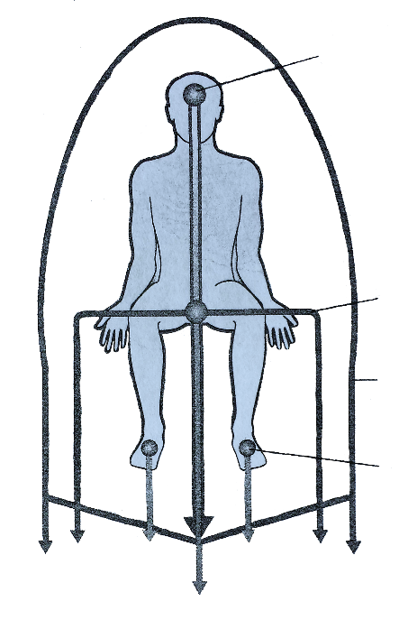
Grounding Channels
MEDITATION SANCTUARY
Grounding
1st CHAKRA
Grounding
AURA
Grounding
FEET CHAKRAS
Grounding

Slide 15
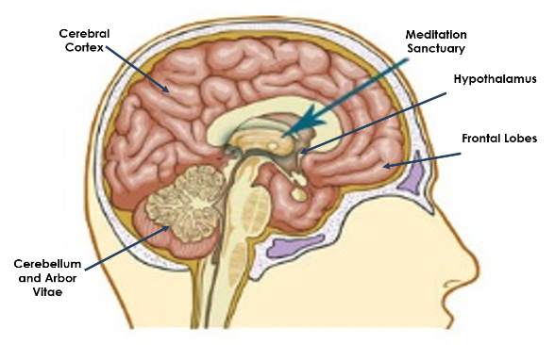
Meditation Sanctuary
Source of your highest intuition

Slide 16
Meditation

Slide 17
Pause and Assess
Are you in synch with your life and soul?
How would you rank your health on a scale of 1-10?
What would it be like if it were a 10?
How would that change your life?

Slide 18
Intention
Arriving
Intention Sharing

Slide 19
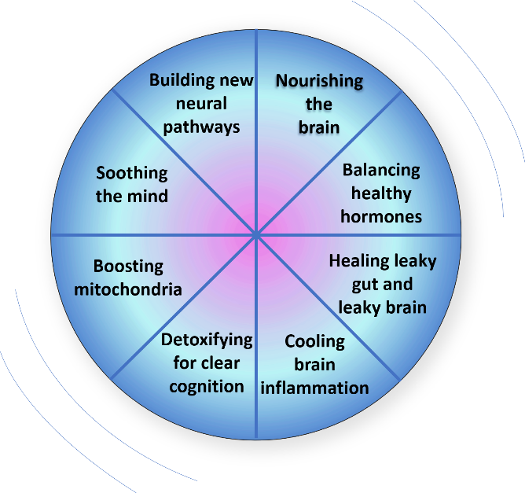
The Wheel of Wellness

Slide 20
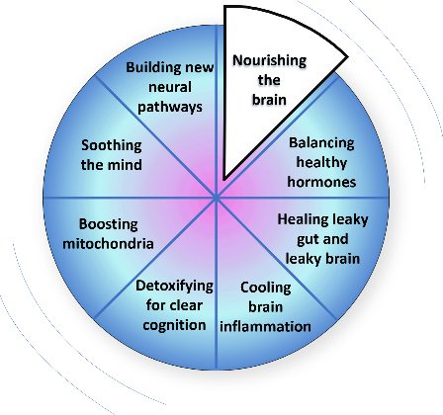
The Mind Diet
Mind Diet Approach (2015) used by UCLA/Buck Institute Research on Aging (2014) and the that helped with memory loss in 9/10 patients:
Eliminating all simple carbohydrates, gluten and processed food from the diet, and eating more vegetables, fruits, and non-farmed fish.)
Notes:
Mediterranean diet was also acceptable. High on berries (strawberries, blueberries

Slide 21
Research
A Mediterranean-style diet replete with fresh fruits and vegetables, whole grains, beans, nuts, fish, low-fat dairy and olive oil. In a major study called MIND (https://www.ncbi.nlm.nih.gov/pmc/articles/PMC4532650/),
Seniors who adopted such a diet and limited their salt intake had a 35 percent lower risk for cognitive decline as they aged, and strict adherence to the diet cut the risk by more than 50 percent.

Slide 22
The Mediterranean Diet
45% calories from complex carbohydrates
20-35% calories from fat
10-35% calories from protein
The Mediterranean diet lowers the odds of getting a heart attack by more than 50% in studies.
Nothing replaces a natural diet consisting of WHOLE foods, pesticide free, free-range, organic.

Slide 23
The Mind Diet:
Avoiding 4 Brain Damaging Foods
The Whites
The Blacks
The Fakes
Alcohol in excess
Notes:
The Whites: white cane sugar, white flour
The Blacks: charcoaled meats
The Fakes: fake fat (trans fats fake, fate sweetener – NutraSweet)
Alcohol in excess (one glass a day for women of wine 4 oz or 2 for men)

Slide 24
The Mind Diet
There are 15 dietary components shown to powerfully impact neurological function:
Notes:
The Whites: white cane sugar, white flour
The Blacks: charcoaled meats
The Fakes: fake fat (trans fats fake, fate sweetener – NutraSweet)
Alcohol in excess (one glass a day for women of wine 4 oz or 2 for men)

Slide 25
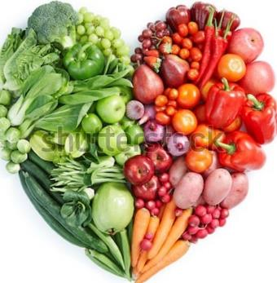
The Mind Diet
Green leafy vegetables
Other vegetables
Nuts
Berries
Beans
Whole Grains
Fish
Poultry
Olive Oil
Wine
Notes:
Image of foods

Slide 26
Rainbow Colors
Phytonutrients are responsible for the “rainbow colors” found in fruits and vegetables such as the red in cherries, the blue in blueberries, the orange in squash, oranges and carrots, and the dark green in spinach.
These brightly-colored phytonutrients defend our cells by helping maintain DNA stability from damage caused by oxidative stress.

Slide 27
Greens
In 2015, researchers at Rush University in Chicago evaluated the diet and mental function of 950 elderly people.
Those participants who ate leafy green vegetables, such as spinach and kale, once or twice a day experienced significantly less cognitive decline than those who didn’t

Slide 28
Greens
In fact, participants who ate greens halted their mental decline by an average of 11 years.
http://www.sciencedaily.com/releases/2015/03/150330112227.htm.

Slide 29
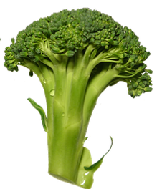
Superfoods to Boost
The Mitochondria
Almonds
Arugula
Avocado
Beef
Blackberries
Blueberries
Bok choy
Broccoli and broccoli sprouts
Brussels sprouts
Buffalo
Cabbage
Cauliflower

Slide 30
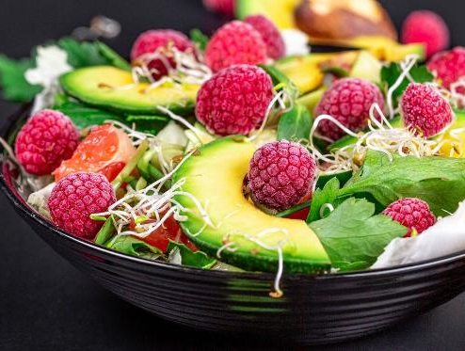
Superfoods to Boost
The Mitochondria
Extra virgin olive oil
Kale
Kohlrabi
Mustard and turnip greens
Pomegranate
Raspberries
Spinach
Strawberries
Turmeric
Virgin coconut oil
Watercress
Wild Pacific salmon

Slide 31
Top Nutrient Dense Foods Nuts
Cashews – copper, iron, folic acid
Hazelnuts – Vit. E, folic acid
Walnuts – B6, Alpha- lipoic acid, omega 3
Almonds – lowered colon cancer rates in mice

Slide 32
Berries
In a study with 9 elderly human participants, a team at the University of Cincinnati found that, compared to a comparable group that was given a placebo, participants who were given blueberry juice scored higher on memory tests, had improved word list recall, and experienced lower depressive symptoms. http://www.ncbi.nlm.nih.gov/pubmed/20047325

Slide 33
Berries
Berries of all types including strawberries, raspberries and blackberries bring you critical minerals , vitamins , antioxidants, flavonoids, polyphenols and a host of other important phytonutirents that are good for your brain, heart and health.

Slide 34
What’s One Very Ordinary
Superfood?
What if I told you there was a study on 80,000 octogenarians looking at their ability to have good cognition in Japan, Greece, Sweden and Spain?
Beans – 2 tbsp a day decreased the risk of dementia by 10%
This Photo by Unknown Author is licensed under CC BY-SA
Notes:
Legumes. Whether it was the Swedes dining on brown beans and peas, the Japanese eating soy, or Mediterraneans enjoying chickpeas, lentils, and white beans, one thing was clear. The more legumes people ate, the longer they lived.

Slide 35
Garlic – not so stinky
Garlic suppresses tumors in breast, colon, skin, uterine, lung, prostate and esophageal cancer.
Garlic may protect against intestinal damage by methotrexate

Slide 36
Garlic – Peel it and Let Sit
Peeling, cutting or crushing garlic releases enzyme allinase.
Allinase starts a series of chemical reactions
Wait 15 min. after crushing, mincing or peeling before cooking.

Slide 37
A Pinch of Salt Keeps the Doctor Away!
Put 1/8-1/4th tsp of salt in a glass of warm water and drink or put a large pinch of salt on your tongue then drink with some water.

Slide 38
Grey or Pink Salt
Salt depleted diets contribute to adrenal fatigue and dehydration
(fatigue, headache or flu-like feeling)
Human body needs full spectrum of ionic trace elements in the natural ratios found in unrefined sea salt in their bioelectric active form.
Proper functioning of bioelectric currents needs correct electrolyte fluid medium which unrefined salt helps maintain.

Slide 39
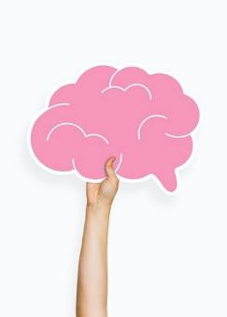
Have You Ever Held a Brain?
The brain is 60% fat
Cell membranes are made of phospholipids
Acting as an outer hub where all the receptor sites are
97% of this fat is DHA – an essential fat
Notes:
Funny photo from Frankenstein movie?

Slide 40
Fats and Your Brain
Inadequate levels of Omega-3s in our diet have been shown to be linked to many physical and mental disorders including:
Depression and anxiety
Bipolar disease and Schizophrenia
ADHD and Dyslexia

Slide 41
Healthy Fats Mean a Healthy Brain
At least 3 studies link Essential Fats with
And a reduction in anxiety, depression and improvement in cognition
What would you think if I told you there is a blood test for that?
Notes:
Image from Shutterstock of the fish

Slide 42
Fats and Your Brain
What else do healthy Omega-3 fats do for our brains aside from building cells and cell membranes?
They also help reduce inflammation, balance blood sugar
They increase the activity of of a key brain molecule called “brain-derived nerve factor” (BDNF) that stimulates new cell growth and increases cell connections.

Slide 43
Fats and Your Brain
Omega 3’s ensure that cell membranes remain elastic instead of becoming stiff and brittle as we age.
When our cell membranes are elastic this improves our brain cell’s ability to receive and send biochemical messages in a clear and distinct way. If our cell membranes aren’t highly functional, the speed of the communication slows.

Slide 44
Fats and Your Brain
Omega-3 fatty acids are available from certain classes of foods. Walnuts, hemp seed, flax seed and chia contain ALA. If you choose to eat flax seed and hemp seed the best way is to use a coffee grinder to grind them into a powder.

Slide 45
Myth #1 – Fat makes you Fat
The study included a total of 46 men and women weighing on average 218 pounds.
The six-month long weight loss program consisted of moderate aerobic exercise and strength training, and one of two diets, either:

Slide 46
Yes on Fat
Low-carb, high-fat: Less than 30 percent of calories from carbs (pastas, breads and sugary fruits), and up to 40 percent from fats (meat, dairy products, and nuts)
Low-fat, high-carb diet: Less than 30 percent of calories from fat, and 55 percent from carbs

Slide 47
Yes on Fat
The low-carb group on average shed 10 pounds in 45 days, while the low-fat group took 70 days to lose the same amount of weight.
In terms of vascular health, the low-carb, high-fat dieters showed no harmful vascular changes.

Slide 48
The Low Carb/High Fat Answer
30% of calories from Carbohydrates
40% of calories from Fat
30% of calories from Protein

Slide 49
What kind of fat?
Heavy whipping cream
Coconut Oil
Medium chain triglycerides
Organic butter/ghee
Olive Oil
Avocado Oil

Slide 50
Amino Acids
Aside from the 60% of fat in your brain the other 40% is amino acids
other part is protein-specifically the amino acid building blocks that get transformed into neurotransmitters. These are messenger molecules that are produced by nerve cells to communicate and control almost every function of your body.

Slide 51
Amino Acids
neurotransmitters are built from the proteins you get in your diet, specifically eight essential amino acids that you must get from the foods you eat.

Slide 52
Make Sure you Get your Protein
Grass Fed Beef
Cage Free Chicken
Wild Fish
Lentils

Slide 53
Vegetarian?
Care must be taken to get enough protein:
15-20 gm. 3x a day for optimal brain chemistry, moods, and blood sugar regulation.
Forty years ago Kansa’s wheat was 16% protein and today it is 7%
Per cup: lentils – 18 gm, black beans 15gm
Per cup: grains- teff 10 gm., brown rice 5 gm.
Per ounce: almonds 6 gm., pumpkin seeds 9gm
Per cup raw: sprouts 1 gm, broccoli 3 gm, carrots 1 gm.

Slide 54
Tumeric
Research has demonstrated that curcumin has antioxidant activity, is an immune cell modulator and has inhibiting effect on certain inflammatory markers (TNF-alpha, ILs). Jurenka J

Slide 55
Tumeric
It’s a root that looks like ginger
Curcumin may help aging blood vessels to relax and increase blood flow to the brain.
At a dose of 2 g curcumin alone, serum levels were either undetectable or very low in human volunteers. But curcumin administered with piperine produced much higher serum concentrations from 0.25—one hour after ingestion with a 2000% increase in bioavailability.

Slide 56
Tumeric and Research
1 Shoba G, Joy D, Joseph T, et al. Influence of piperine on the pharmacokinetics of curcumin in animals and human volunteers. Planta Med 1998 May;64(4):353- 56. [PMID: 9619120]
2 Altern Med Rev. 2009 Jun;14(2):141-53. [PMID: 19594223] 3. Jagetia GC, Aggarwal BB. “Spicing up” of the immune system.
Various animal and human studies support its use in promoting health in joints, gastrointestinal mucosa, neural cell health, and amyloid plaques in the brain. The typical dose in human studies
ranged from 3.75 mg-1,200 mg.1

Slide 57
Vitamins and Minerals
Patients sometimes ask me a very good question: Is it really necessary to supplement with extra vitamins and minerals?
The short answer is: No, as long as you are eating wild, fresh, whole, organic, local, non-genetically modified foods grown in virgin mineral and nutrient-rich soils, freshly picked and not transported across vast distances or stored for months.

Slide 58
Super Vitamins and Minerals
Vitamin D
B vitamins
Magnesium
Zinc
Selenium
Lithium

Slide 59
Vitamins and Minerals
Vitamins act as cofactors that run all aspects of your biochemistry.

Slide 60
Vitamin D
We need vitamin D for so many things, including production of serotonin (our “happy-mood” neurotransmitter)
To activate our thyroid hormone
To aid our immune system in determining which immune T helper cells to activate as well as to shuttle amyloid protein out of the brain

Slide 61
Vitamin D
Unfortunately, deficiency in vitamin D affects over about a third of the population. From the British Journal of Nutrition. 2018 Apr ;119(8):928-936. PMID: 29644951 by Xuefeng Liu, Ana Baylin, Phillip D Levy.
Vitamin D levels in rats have been shown to help the blood brain barrier. http://www.greenmedinfo.com/article/vitamin-d-deficiency-increases-blood-brain-barrier-dysfunction-after-ischemic.

Slide 62
B Vitamin
Vitamin B-12 is crucial to the normal function of the brain and the nervous system. It is also involved in the formation of red blood cells and helps to create and regulate DNA.
The metabolism of every cell in the body depends on vitamin B-12, as it plays a part in the synthesis of fatty acids and energy production.

Slide 63
Magnesium
Think of magnesium as the relaxation mineral. If there is stiffness or cramping in your body or brain, you may need more of it. Conditions such as an anxious, “tight” mood; a head “tight” with headaches; or bowels “tight” from constipation—all of these are most likely due to magnesium deficient

Slide 64
Magnesium
Magnesium is one the most essential minerals. It is involved in over 300 enzyme processes and is needed to generate ATP, our bodies source of energy.

Slide 65
Magnesium and Vit. D
Up to 50 percent of US population is magnesium deficient. Vitamin D can’t be metabolized without sufficient magnesium levels, meaning Vitamin D remains stored and inactive for as many as 50 percent of Americans
Magensium 200 mg a day-800 mg

Slide 66
Magnesium
Standard serum or blood levels of magnesium do not reflect accurate body magnesium levels. The best way to know if you have enough magnesium is to check it through red blood cell content of magnesium.

Slide 67
Zinc
More than a third of the world’s population is zinc deficient, which is alarming because zinc is used by more enzymes in the body than any other mineral.
Zinc 30 mg a day

Slide 68
Selenium
Selenium is used for diseases of the heart and blood vessels, including stroke and “hardening of the arteries” (atherosclerosis). It is also used for preventing various cancers including cancer of the prostate, stomach, lung, and skin.
Selenium 200 mcg a day https://www.webmd.com/vitamins/ai/ingredientmono-1003/selenium.

Slide 69
Selenium
It’s 1,000 times more potent than Vit. C and Vit. E as an antioxidant
Selenium supports the thyroid, and which is critical for brain health.
Selenium is a cofactor for glutathione peroxidase, the most important antioxidant for the brain and liver.

Slide 70
Lithium
Dr. Gregory Moore, director of Brain Imaging Research Center at Wayne State University’s School
Led a study to see if whether or not lithium could increase the brain’s gray matter, the part of the brain that is most involved with memory and thinking.
Shockingly after 4 weeks of taking lithium the MRI tests revealed that the study participants had significantly increased their brain’s gray matter

Slide 71
Lithium
People taking lithium have been found to have significantly higher gray matter volume.
Nerve cells exposed to lithium respond by increasing in dendritic number and length.

Slide 72
Lithium
Lithium ions also help the brain repair from damage that has already happened in Alzheimer’s by encouraging the synthesis and release of key neurotropic factors such as brain derived neurotropic factor (BDNF) and neurotrophin-3 (NT-3), which stimulate the growth and repair of neurons.

Slide 73
Lithium
Lithium has been shown to disrupt a key enzyme responsible for the development of amyloid plaques and neurofibrillary tangles associated with Alzheimer’s, which are caused by increased enzyme, is GSK-3, glycogen synthase kinase -3 activity.
Lithium works as a direct GSK-3 inhibitor halting inappropriate amyloid production.

Slide 74
The Mind Diet
Meditating twice a day and beginning yoga to reduce stress
Sleeping 7-8 hours per night
Fasting a minimum of 12 hours between dinner and breakfast and a minimum of 3 hours between dinner and bedtime.
Exercising a minimum of 30 minutes, 4-6 days per week.
Notes:
Image of meditator, sleep, exercise

Slide 75
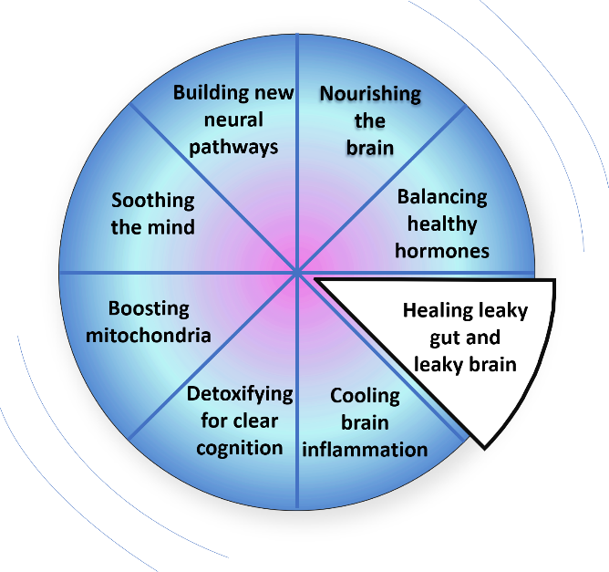
The Wheel of Wellness

Slide 76
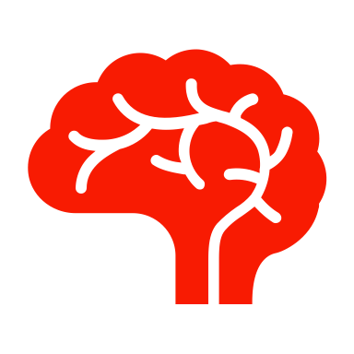
Healing the Leaky Gut
And the Leaky Brain
What do the blood brain barrier and gut lining have in common?
They are highly selective semipermeable border that represents the circulating blood from the brain and extracellular fluid in the CNS.

Slide 77
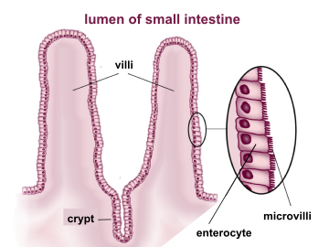
Intestinal Layer
Intestinal epithelium is a single cell layer that constitutes the largest most important barrier against the external environment.

Slide 78
Study From Lancet
A study published in the Lancet found subjects with inflammatory bowel disease developed white-matter lesion in the brain, as identified by magnetic resonance imaging (MRI), with almost the same frequency as patients with multiple sclerosis (a disease of brain myelin destruction.
Maes, M, Kubera, M, an Leunis, JC. “The gut-brain barrier in major depression: Intestinal mucosal dysfunction with an increased translocation of LPS from gram negative enterobacteria (leaky gut) plays a role in the inflammatory pathophysiology of depression. Neuro Endocrinol Lett. 2008;29(1):117-124. pubmed.ncbi.nlm.nih.gov/18283240/

Slide 79
Study From Lancet
In fact, 42 percent of patients with Crohn’s disease and 46 percent of patients with ulcerative colitis have white matter lesions in their brains.
Notes:
Another shocking statistic that supports the link between the inflammation in the gut and in the brain is that 50 to 90 percent of those with irritable bowel syndrome also had panic disorder, post-traumatic stress disorder, generalized anxiety, and depression.

Slide 80
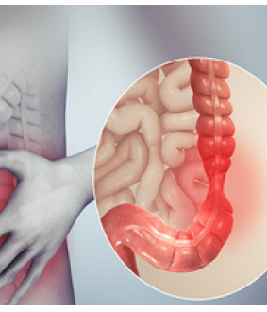
Shocking Statistic
50 to 90 percent of those with irritable bowel syndrome also had panic disorder, post-traumatic stress disorder, generalized anxiety, and depression.
Notes:
Supporting the link between the gut and brain

Slide 81
The Causes of Leaky Gut
Diet: alcohol, gluten, casein, processed foods with food coloring or preservatives, excess sugar, food allergies
Medications: corticosteroids, antibiotics, antacids, xenobiotics
Infections: Helicobacter pylori (H. pylori), bacterial overgrowth, yeast overgrowth, intestinal virus, parasitic infection

Slide 82
The Causes of Leaky Gut
Hormonal: decreased levels of thyroid hormone, testosterone, estrogen, or progesterone
Stress: increased cortisol
Neurologic: brain trauma, stroke, neurodegeneration
Metabolic: glycosylated end products, intestinal inflammation, autoimmune conditions
Glyphosate: a pesticide used in agriculture, which can be in our drinking water and food

Slide 83
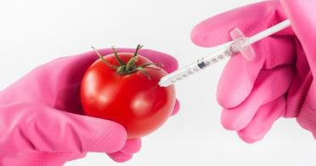
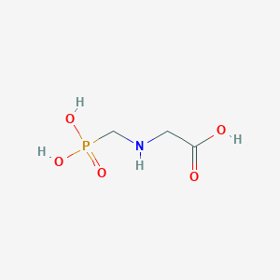
Glyphosate:
One of the most toxic agrichemicals
in use today
Glyphosate is a non-selective herbicide, meaning it will kill most plants. It prevents the plants from making certain proteins that are needed for plant growth. Glyphosate stops a specific enzyme pathway, the shikimic acid pathway. The shikimic acid pathway is necessary for plants and some microorganisms.
This Photo by Unknown Author is licensed under CC BY-NC
Notes:
Yet another physiological process that GMOs block, which can cause mood issues and ADHD, is the shikimate pathway in plants. What this means is that the genetically modified plants we eat can’t create the essential amino acids we need to help our mood. Glyphosate works by inhibiting the synthesis of tryptophan, phenylalanine, and tyrosine in plants. Interestingly, humans need these three amino acids to make our appropriate happy or peaceful brain chemistry

Slide 84
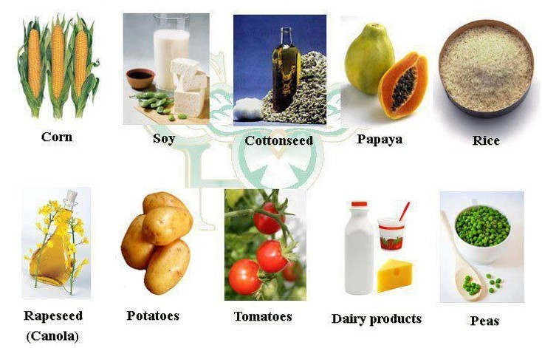
The Top Ten Genetically Modified
Food Crops
Notes:
Avoid These

Slide 85
The Power of the
Intestinal Microbiome

Slide 86
Fertilizer for the Brain and Gut
Nourish our intestine wall cells
Helps digestive motility
Enters our bloodstream, crossing the BBB
Facilitates the production of brain derived neurotrophic factor.
Notes:
The most famous of the short chain fatty acids is butyrate, which has been discovered to not only

Slide 87
Fertilizer for the Brain and Gut

Slide 88
The Power of the
Intestinal Microbiome
The gut has its very own neurotransmitters. In fact, every class of neurotransmitter found in your brain is also found in your gut, including serotonin, 95 percent of which resides in your gut
The intestinal microbiome is closely involved in the enteric nervous system, with bidirectional communication through the valgus nerve.

Slide 89
The Power of the
Intestinal Microbiome
The intestinal microbiome is closely involved in the enteric nervous system, with bidirectional communication through the vagus nerve.

Slide 90
Our brain is our most crucial
and dynamic organ

Slide 91
If we want to have healthy brains, we need to nourish our bodies with the right raw materials for building our brain chemistry, our cell membranes, and the nerves themselves. :
Essential fats
Key amino acids from protein
Vitamins and minerals
Fresh fruits, vegetables, and complex carbohydrates

Slide 92
Basic Plan to Fix the Gut

Slide 93
Basic Plan to Fix the Gut
Hydrochloric Acid
A special probiotic
Scientists at Pacific Northwest National Laboratory have demonstrated that boosted levels of Lactobacillus are directly linked to enhanced memory.

Slide 94
Yogurt
This Photo by Unknown Author is licensed under CC BY-SA
Notes:
Higher levels of GABA, which of course is produced by some species of gut bacteria, are also associated with better memory.

Slide 95
Basic Plan to Fix
Brain Inflammation
Add anti-inflammatory spices such as turmeric, ginger, and rosemary to your diet.
Develop love, community, and connection.
Eat real, whole, hormone-free and pesticide-free foods.
Eliminate hidden food allergies.
Exercise regularly
Get a cranial osteopathic treatment.
Get adequate sleep.
Heal emotional trauma
Take helpful supplements and herbs

Slide 96
5-9 servings of greens a day
One cup of raw greens = ½ cup of cooked vegetables counts as a serving.
The best greens to eat are: the dark leafy ones cruciferous vegetables.
Cruciferous vegetables can be harder to digest, so lightly steaming for 5 minutes at less than 118 degrees can them can help the mineral content become more bioavailable without overcooking and destroying the vitamins.

Slide 97
What impacted you most during this talk?

Slide 98
Action Steps
Write down three things you learned that you can implement right now that would make the greatest difference in your life.
This Photo by Unknown Author is licensed under CC BY-SA-NC
Notes:
In the BCP you get the CBS cognitive test, you get self assessment tools, a question and answer period with me.

Slide 99
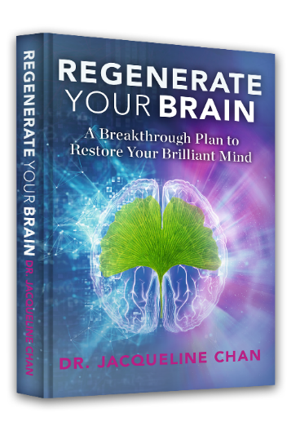
Action Steps
Read the book:
Regenerate Your Brain: A Breakthrough Plan to Restore Your Brilliant Mind
Consider signing up for the Brain Care Program- 8 weeks
Become a patient

Slide 100
8-Week Brain Care Program
Here’s what you get:
8 in depth modules
Self-paced
Self assessment tools
Custom tracking logs
Educational handouts
State of the Art Cognitive Test
Access to on-line store for doctor brand supplements
A chance to talk to Dr. Jacqueline Chan

Slide 101
Cognitive Test
Test assesses aspects of cognition including reasoning, memory, attention and verbal ability
30 min. test is comparable to a 2-3 hour paper and pencil neuropsych test.
CBS outperformed the MOCA test.
Based on a 7 million completed tests
Developed after 600 published studies based on 25 years of PET and fMRI scans
Fun, engaging and doesn’t require any technical support.
Notes:
CBS- developed by Dr. Adrian Owen, Canada Excellence Research Chair in Cognitive Neuroscience and Imaging
Developed after 600 published studies in 25 years based on PET and fMRI

Slide 102
www.drjacqueline.com
braincareprogram@gmail.com

