Slide 1
Session 2: Reflection Hand Out The Art of Bringing People Together for Shared Purpose
Envision a gathering you anticipate designing or simply joining in the future
What are 1-2 ways you can engage the head/the heart? (Use the excerpted slides from our second session as a refresher.)
What questions/concerns might you need to problem solve?

Slide 2
REFRESHER: THE HEAD Success requires conceptual clarity
Opportunities for Clarity | Implications and Approaches
Set Up
State objectives, agenda, discussion process, time, learning items, decision items, decision process
Define Success
Frame the day’s work (issue/problem)
“By the end of the meeting, we will…”
Hold all accountable
“Today’s work is fundamentally about …”
“It fits into our longer term project in this way…”
Do it: up top, in each section, summarizing at various points along the way
Interpret Meaning
Translate incoherent comments: restate, reframe
Reflect back to speaker, ask questions

Slide 3
REFRESHER: HEAD (cont.) Success requires conceptual clarity
Opportunities for Clarity | Implications and Approaches
Foster new learning, widen lens beyond perspectives in the room, build consensus, gain credibility, sustain agreements
“How does this mesh with the data picture?”
Tap data
Clear, dynamic, just right amount of data
Couple with material (possibly lengthier) shared in advance
Use visuals
Take stock of multiple comments, explicitly draw the through line
Call for adding on to what previous person has said
Observe points of emerging consensus and/or different lines of thinking
Connect the dots

Slide 4
REFRESHER: THE HEART Success requires social and emotional intelligence
Human Qualities That Require Some Emotional Intelligence | Implications and Approaches
People like boundaries
Generate meeting code of conduct, confirm shared agreement, revisit and remind of norms if needed
People learn differently
Use different meeting formats: large and small groups, dyads, personal reflection, reading silently
People like affirmation, feeling validated, and feeling like their effort is worthwhile
Acknowledge progress made (during meeting, over life span of project, after key agreements are reached)
Summarize discussion points
Refer back to specific useful comments (crediting who made them)

Slide 5
REFRESHER: HEART (cont.) Success requires social and emotional intelligence
Human Qualities That Require Some Emotional Intelligence | Implications and Approaches
People change their minds (and need to save face if they do so)
Build in exercises for listening, considering, and changing (sticker dots, fist to five)
Sequence learning and decision-making
Ensure adequate set up for making decisions
Use leaders to frame why groups are ready to come to a decision together
Identify areas requiring further thinking, use “parking lot,” assure process/identify steps for addressing outstanding matters
People move at a different pace
Bring all voices into the room
Name different people’s comments throughout
Invite different stories, experiences
People think differently

Slide 6
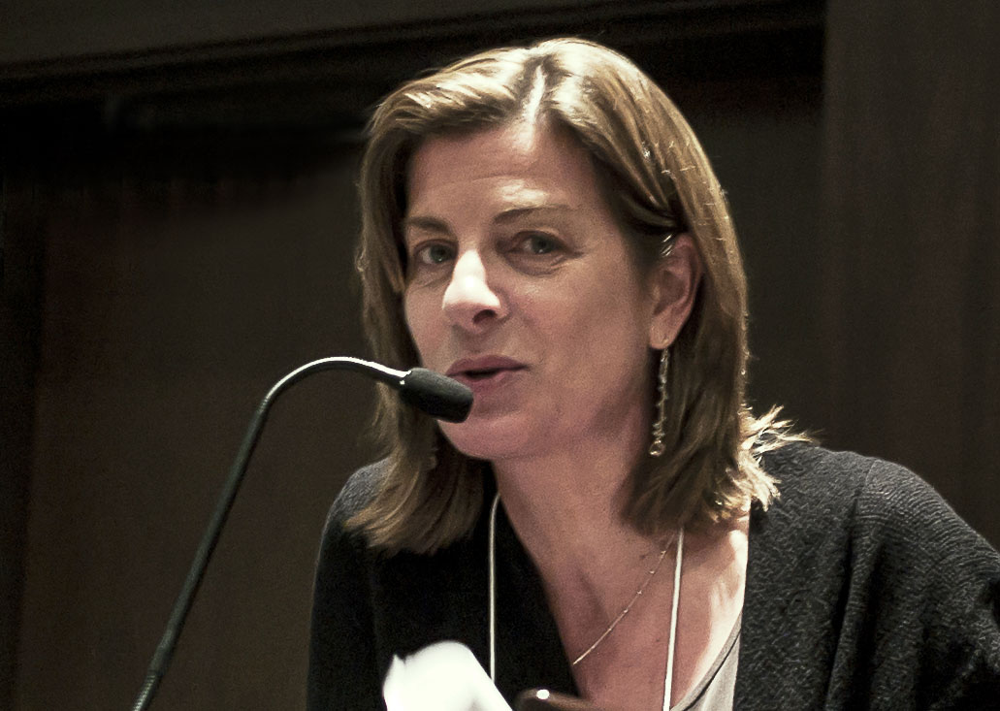
Thank you. Melinda Fine, Ed.D., Founder and Principal
Fine Consulting
try out?
Collaborating for Progressive Change
Web: fineconsultingllc.org
Email: melinda@fineconsultingllc.org
Phone: (917) 359-3215

